Slide 1

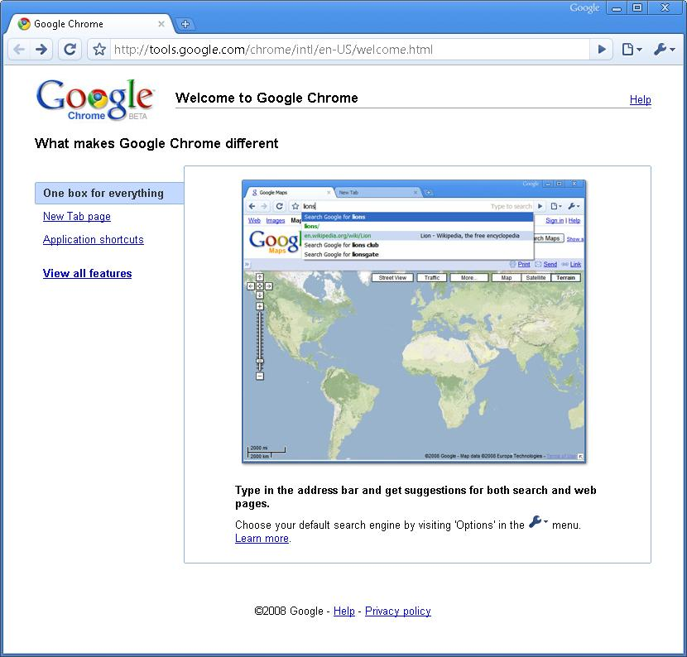
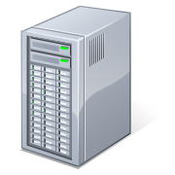
Spark Debugger
Leveraging computation structure to debug in the datacenter
Murphy McCauley, Matei Zaharia, Tathagata Das, Scott Shenker, Ion Stoica
Motivation
Spark Studio
Debugging distributed datacenter applications is hard and slow, especially for non-experts
Performance of multi-stage parallel computations can have non-intuitive behavior
General-purpose distributed debuggers use logging, but have high overhead and too low level information
Spark makes writing distributed applications fast and intuitive. Can it also make debugging fast?
A light-weight browser-based integrated debugging environment
Non-expert users can edit, debug, and visualize Spark applications on the cluster
Specifically, it allows the user to …
Visualize the lineage graph of generated RDDs
Reconstruct a specific RDD using the lineage and interactively run queries on it
Analyze logs distributed across the cluster
RDD Graph
Code
RDD
// Cache an RDD containing all the
// lines with “ERROR” in a log file
file = spark.textFile("hdfs://...”)
errs = file.filter(_.contains("ERROR"))
cachedErrs = errs.cache()
// Count errors using the cached RDD
ones = cachedErrs.map(_ => 1)
count = ones.reduce(_+_)
filter(_.contains(...))
Filtered RDD
cache()
Logs
Cached RDD
map( _ => 1 )
Mapped RDD
Debug Hub
Spark Shell
_{Master Node}
Logs
Logs
Logs
_{Worker} _{Nodes}
Approach
Screenshots
Future Plans
Leverage inherent structure of the computation in Spark-based applications
Independent units of work with no shared mutable state between them
Lineage of operations make program state re-constructible, with minimal logging overhead
Similar techniques can be applied to other frameworks (MapReduce, Dryad, Pregel, etc)
Performance profiling
Execution time profiles
Memory usage profiles
More visualizations
Node-specific task schedule view
Data visualizations
System status
Higher level counters like number of garbage collections
Suggestions from Spark users,
you tell us!

Slide 2
Spark Debugger
Leveraging computation structure for debugging parallel applications
Murphy McCauley, Matei Zaharia, Tathagata Das, Scott Shenker, Ion Stoica
Motivation
Spark Studio
Debugging distributed datacenter applications is hard and slow, especially for non-experts
Performance of multi-stage parallel computations can have non-intuitive behavior
General-purpose distributed debuggers use logging, but have high overhead
Spark makes writing distributed applications fast and intuitive. Can it also make debugging fast?
A light-weight browser-based integrated debugging environment, that lets non-experts to edit, debug, and visualize Spark applications on the cluster
RDD Graph
Code
RDD
// Cache an RDD containing all the
// lines with “ERROR” in a log file
file = spark.textFile("hdfs://...”)
errs = file.filter(_.contains("ERROR"))
cachedErrs = errs.cache()
// Count errors using the cached RDD
ones = cachedErrs.map(_ => 1)
count = ones.reduce(_+_)
filter(_.contains(...))
Filtered RDD
cache()
Logs
Cached RDD
map( _ => 1 )
Visualize
Visually interact with the lineage graph of the generated RDDs
Mapped RDD
Debug Hub
Spark Shell
_{Master Node}
Replay and Debug
Reconstruct a specific RDD and interactively run queries on it
Logs
Logs
Logs
_{Worker} _{Nodes}
Visualization showing reconstruction of specific RDD by partial execution
Approach
Log Analysis
Analyze execution logs distributed across the cluster
Leverage inherent structure of the computation in Spark-based applications
Independent units of work with no shared mutable state between them
Lineage of operations make program state re-constructible, with minimal logging overhead
Similar techniques can be applied to other frameworks (MapReduce, Dryad, Pregel, etc)
Future Plans
Screenshots
Performance profiling
More visualizations
Task schedule view
Data visualizations
System status
Higher level counters like number of garbage collections
Suggestions from Spark users,
you tell us!

